Slide 1
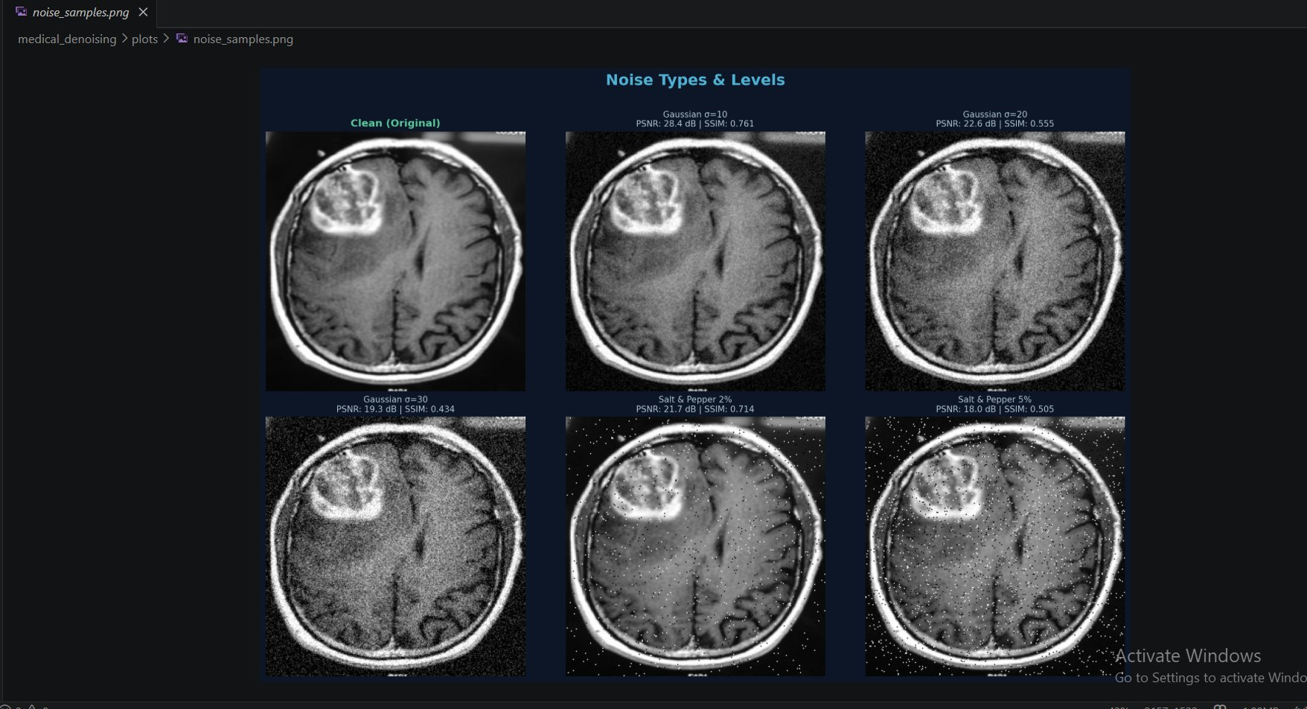
DIGITAL IMAGE PROCESSING — FINAL PROJECT
Noise Removal in
Medical Images
Remove noise while preserving edges in MRI or CT images
Mardonali Fayzullayev · ID: 230423 · 2025
Mardonali Fayzullayev · ID: 230423 · Digital Image Processing
1 / 14

Slide 2
Presentation Overview
What we will cover today
01
Introduction & Problem
08
Full Summary Dashboard
Why noise in MRI/CT matters
All methods, all noise types
02
Dataset
09
Best Method Analysis
Brain MRI — 200 images
Winners per noise type
03
5 Denoising Methods
10
Edge Preservation
Classical to Deep Learning
Visual edge map comparison
04
Methodology Pipeline
11
Discussion
Step-by-step workflow
Key findings & insights
05
DnCNN Training
12
Limitations
Neural network results
Current constraints
06
Gaussian Noise Results
13
Future Work
σ=10, 20, 30 comparison
Extensions
07
Salt & Pepper Results
14
Conclusion
d=2%, 5% comparison
Summary & Q&A
Mardonali Fayzullayev · ID: 230423 · Digital Image Processing
2 / 14

Slide 3
Introduction
The critical role of medical imaging
🏥
MRI & CT are the primary diagnostic tools — noise corrupts them during acquisition.
⚠️
Gaussian noise (MRI) and Salt & Pepper noise (CT) degrade image quality.
🔬
Edge blurring from naive filters destroys clinically important boundaries.
💡
We compare 5 methods: Median, Gaussian, Bilateral, NLM, DnCNN.
Mardonali Fayzullayev · ID: 230423 · Digital Image Processing
3 / 14

Slide 4
Dataset & Preprocessing
Brain MRI Images for Brain Tumor Detection (Kaggle)
200
256×256
140/30/30
5
MRI Images
Image Size
Train/Val/Test
Noise Variants
Mardonali Fayzullayev · ID: 230423 · Digital Image Processing
4 / 14

Slide 5
5 Denoising Methods
From classical filters to deep learning
01
Median Filter
Classical
Non-linear; replaces pixel with neighbourhood median
02
Gaussian Filter
Classical
Linear low-pass; reduces Gaussian noise, blurs edges
03
Bilateral Filter
Advanced
Edge-aware; weights by spatial AND intensity distance
04
Non-Local Means
Advanced
Patch-based self-similarity across entire image
05
DnCNN
Deep Learning
Residual CNN; 17 layers, trained 50 epochs, MSE loss
Mardonali Fayzullayev · ID: 230423 · Digital Image Processing
5 / 14

Slide 6
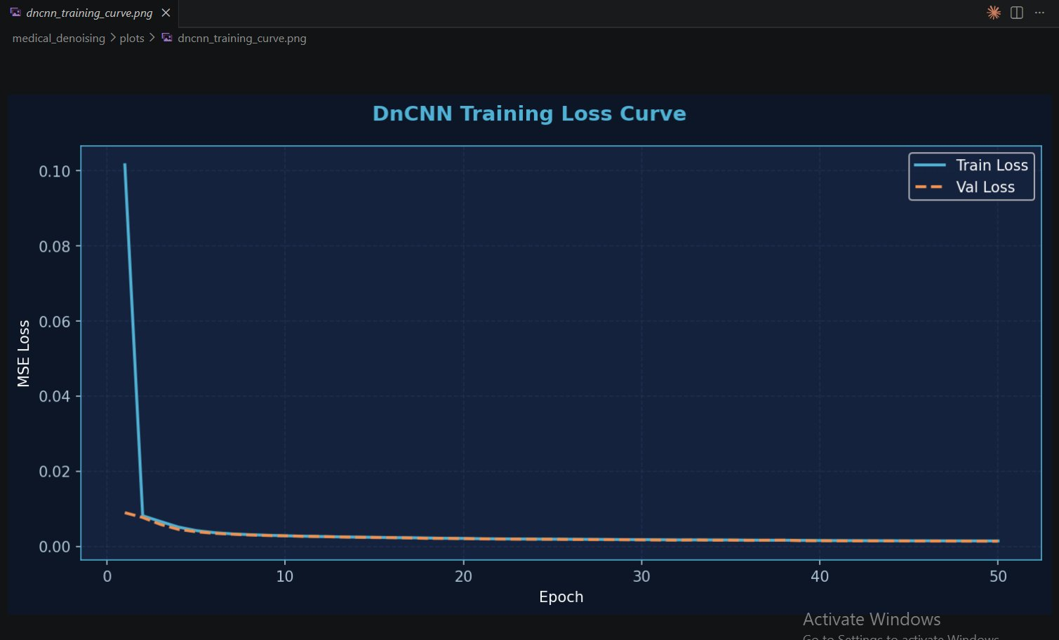
DnCNN Training Results
50 epochs on CPU — Best val loss: 0.001351
556,097
Parameters
0.1016
Initial Loss
0.0014
Final Loss
50
Epochs
Mardonali Fayzullayev · ID: 230423 · Digital Image Processing
6 / 14

Slide 7
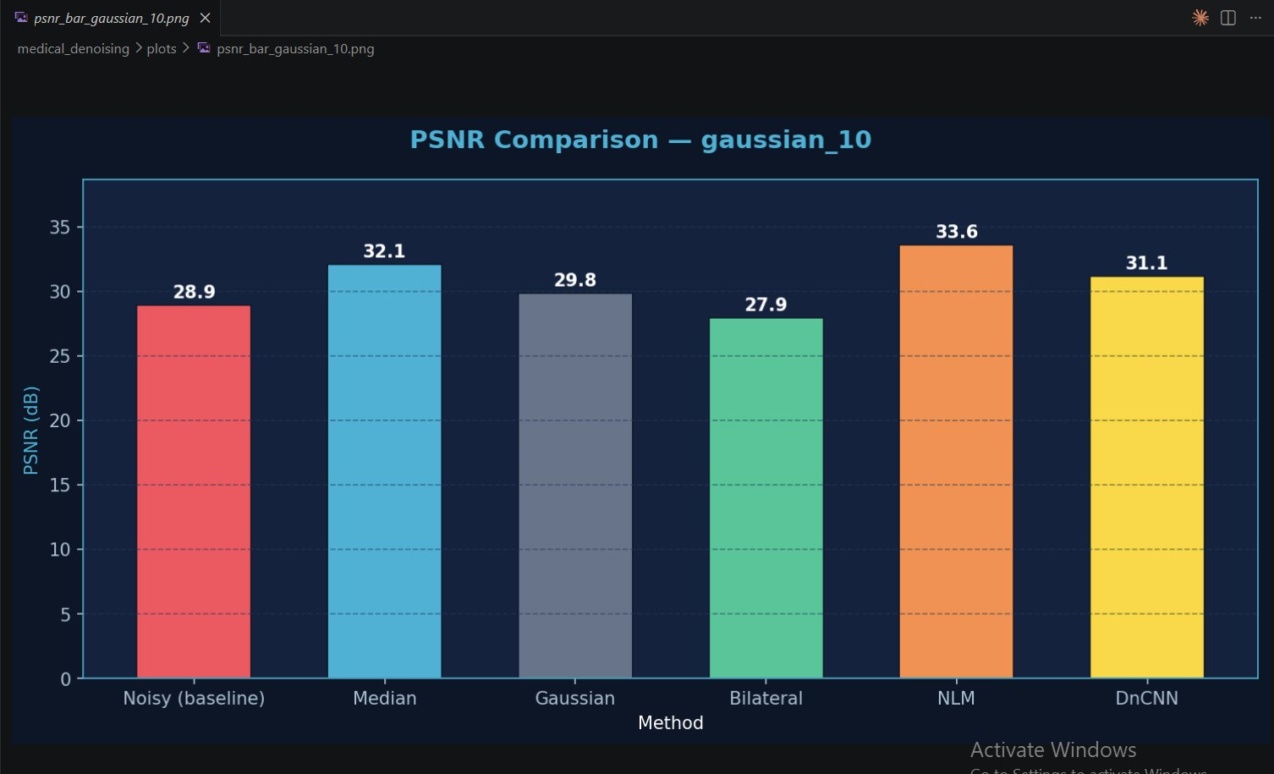
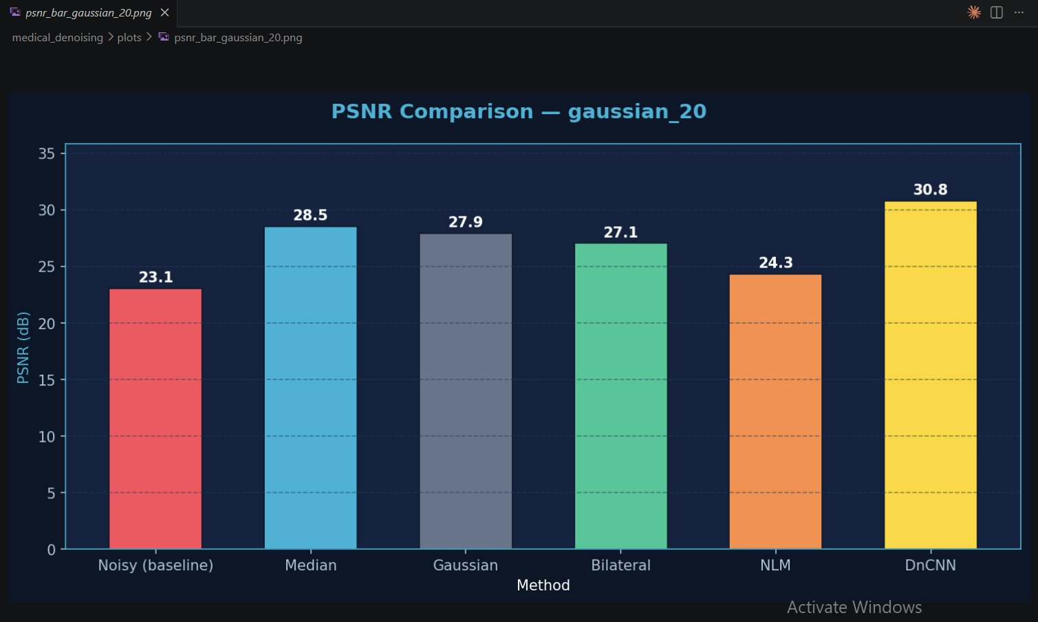
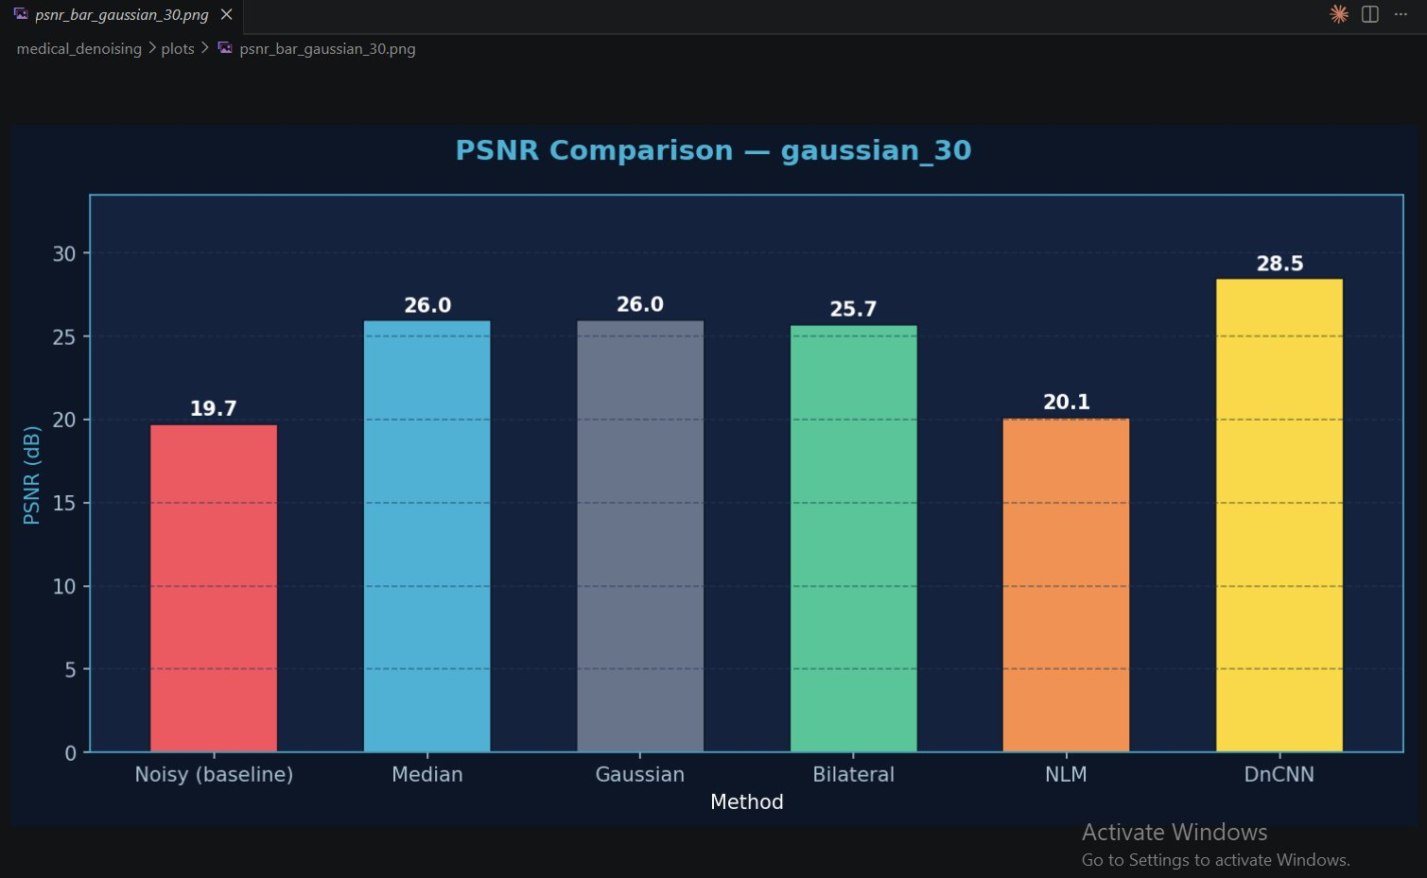
Gaussian Noise Results
σ=10, 20, 30 — PSNR comparison
σ=10
σ=20
σ=30
▶ σ=10: NLM best (33.6 dB) — global self-similarity advantage
▶ σ=20: DnCNN leads (30.8 dB) — deep learning takes over
▶ σ=30: DnCNN dominates (+2.5 dB over classical methods)
Mardonali Fayzullayev · ID: 230423 · Digital Image Processing
7 / 14

Slide 8
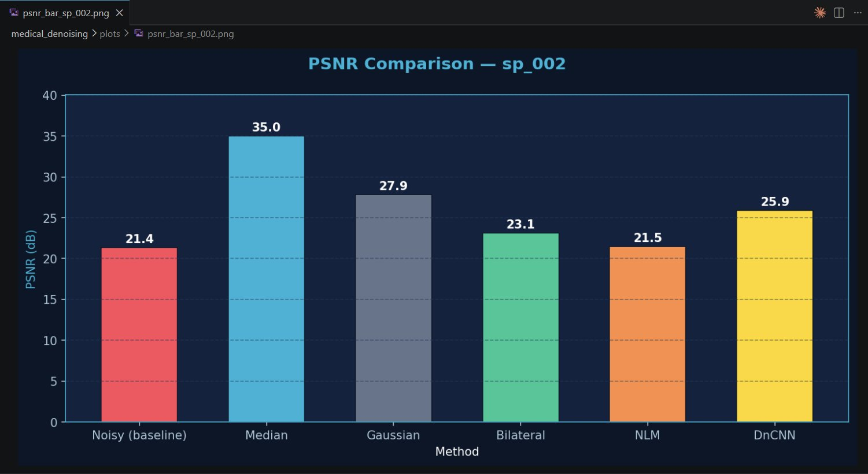
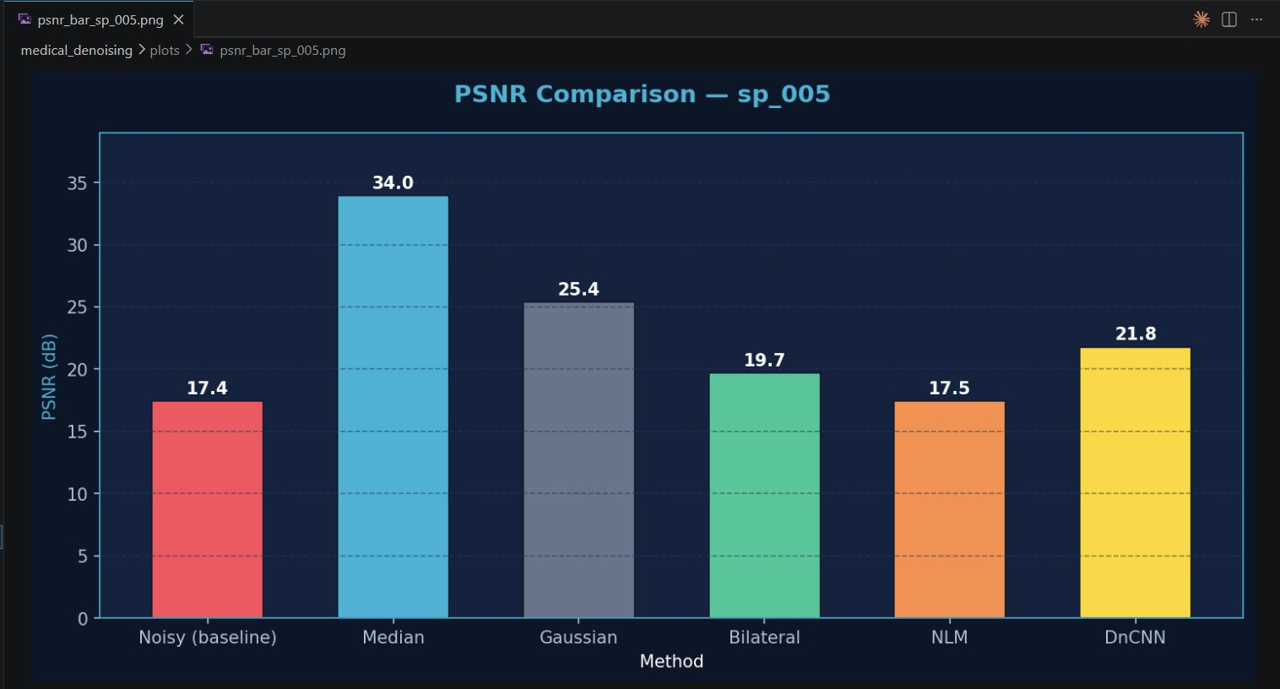
Salt & Pepper Noise Results
d=2% and d=5% — Median Filter dominates
▶ Median PSNR=35.03 dB at 2% — far exceeds all other methods
▶ Median SSIM=0.974 (2%) and 0.971 (5%) — near-perfect reconstruction
▶ DnCNN (trained on Gaussian) performs poorly on S&P noise
Mardonali Fayzullayev · ID: 230423 · Digital Image Processing
8 / 14

Slide 9
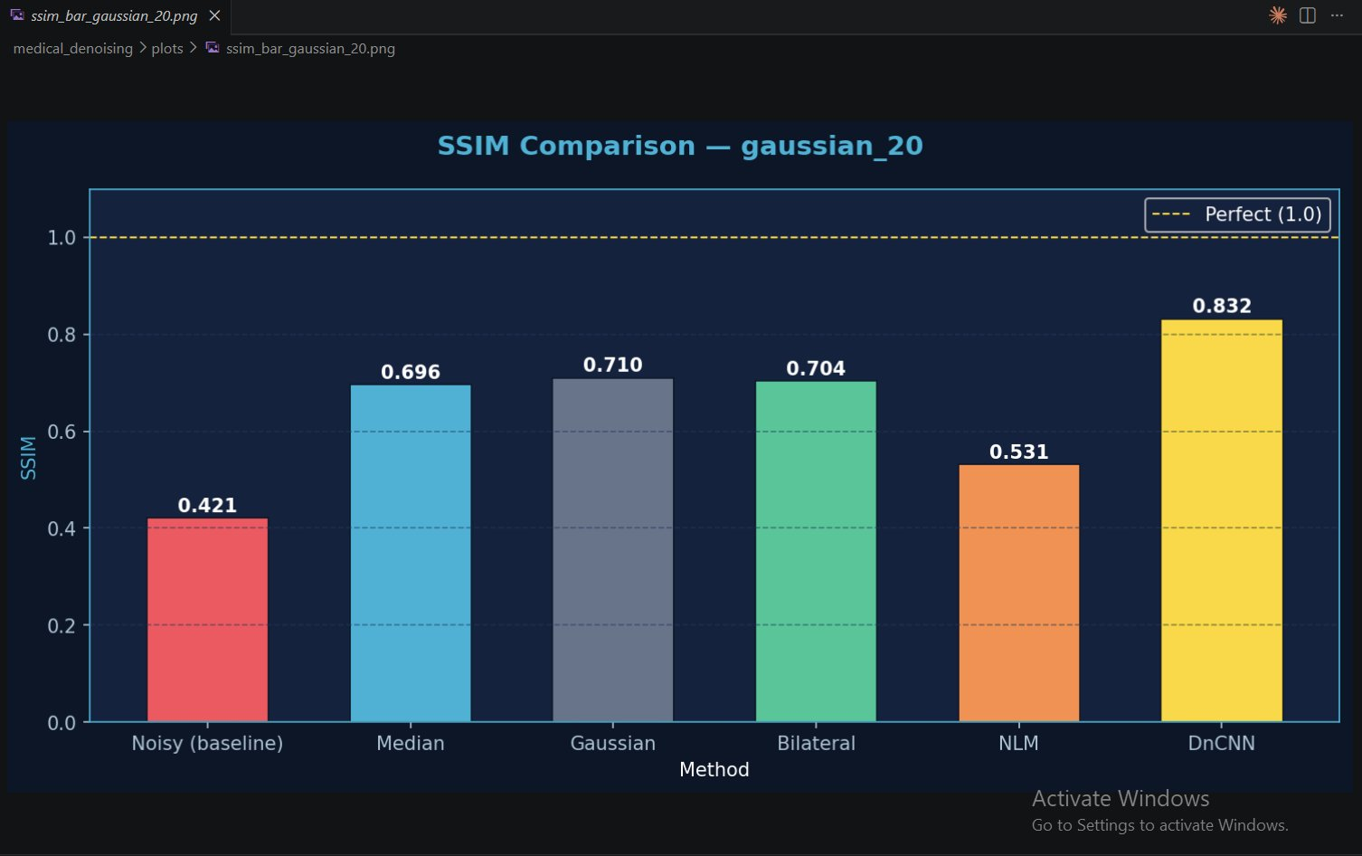
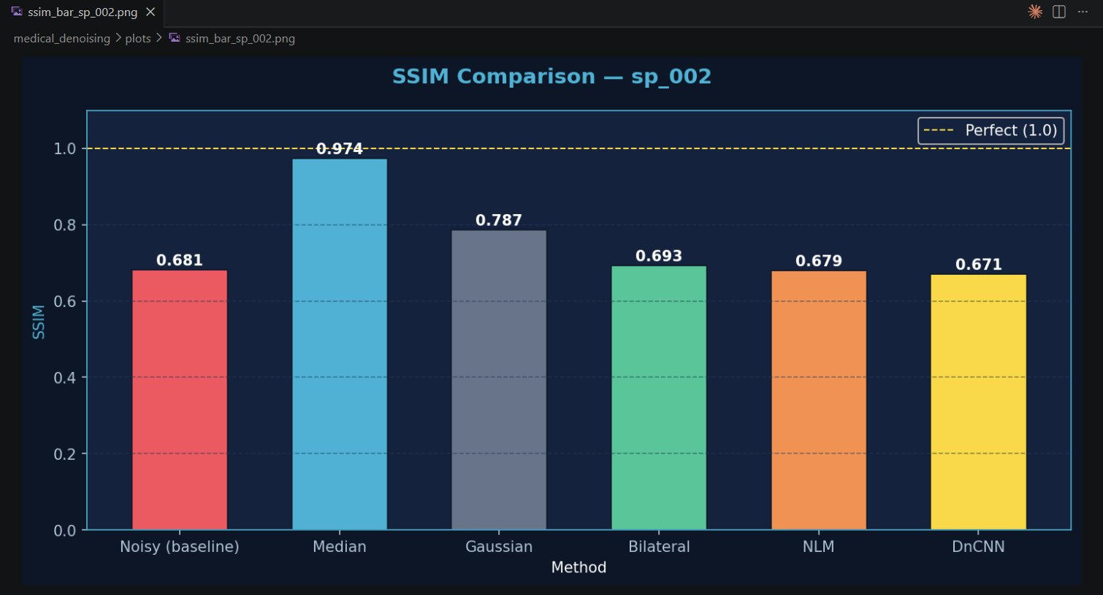
SSIM Results
Structural Similarity — perceptual quality measure
Gaussian σ=20
Salt & Pepper 2%
DnCNN achieves SSIM=0.832 for Gaussian noise vs Median's 0.974 for S&P — each method excels in its domain
Mardonali Fayzullayev · ID: 230423 · Digital Image Processing
9 / 14

Slide 10
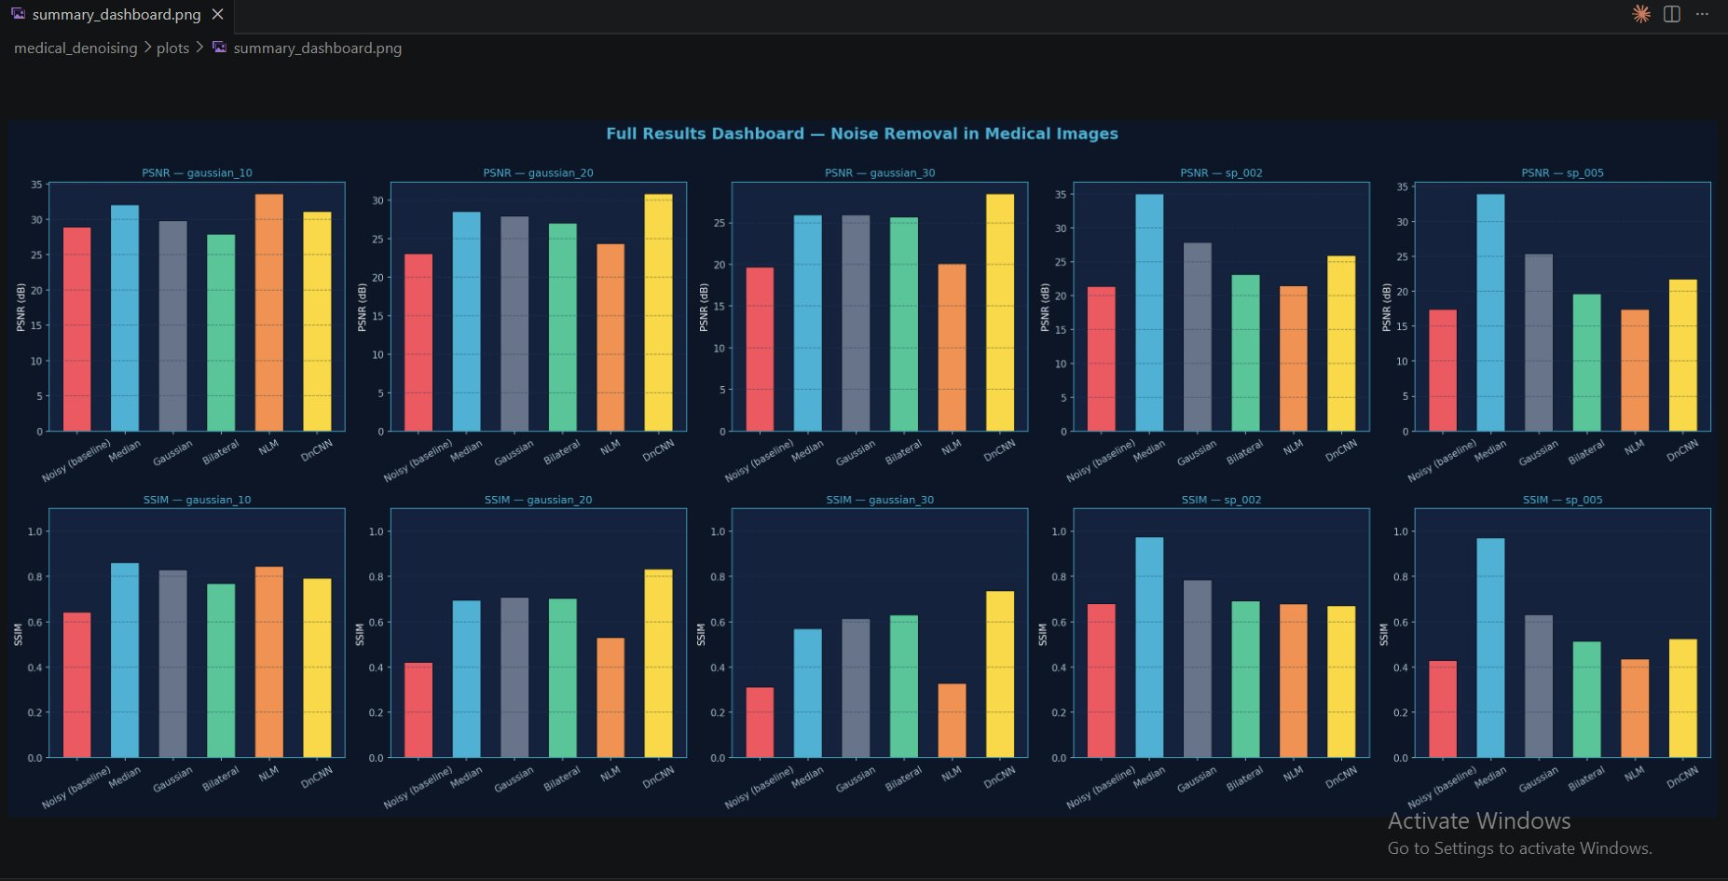
Full Results Dashboard
PSNR & SSIM across all 5 noise types
Mardonali Fayzullayev · ID: 230423 · Digital Image Processing
10 / 14

Slide 11
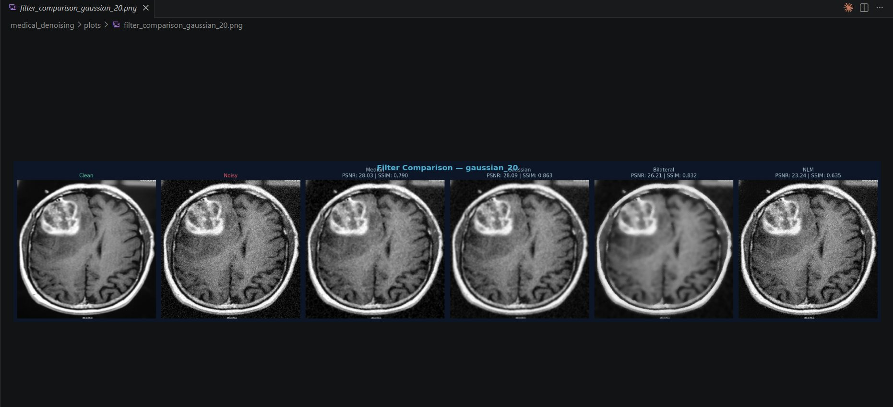
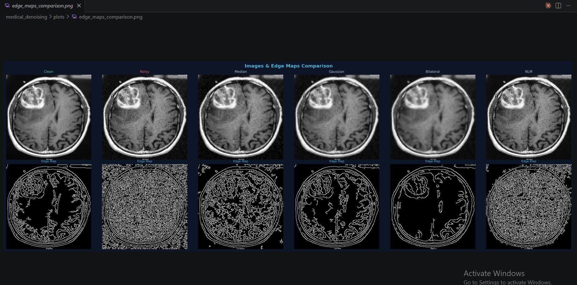
Visual Filter Comparison
Gaussian σ=20 — side-by-side denoising results
Mardonali Fayzullayev · ID: 230423 · Digital Image Processing
11 / 14

Slide 12
Best Method Per Noise Type
Key findings & recommendations
Gaussian σ=10
NLM
PSNR: 33.62 dB
Best for: Light Gaussian noise
SSIM: 0.8443
Gaussian σ=20
DnCNN
PSNR: 30.82 dB
Best for: Heavy Gaussian noise
SSIM: 0.8321
Gaussian σ=30
DnCNN
PSNR: 28.47 dB
Best for: Heavy Gaussian noise
SSIM: 0.7373
Salt & Pepper 2%
Median
PSNR: 35.03 dB
Best for: Any S&P noise
SSIM: 0.9739
Salt & Pepper 5%
Median
PSNR: 33.95 dB
Best for: Any S&P noise
SSIM: 0.9712
Mardonali Fayzullayev · ID: 230423 · Digital Image Processing
12 / 14

Slide 13
Discussion & Limitations
Key insights from the experiments
Key Finding 1
Limitation 1
No single method is optimal — noise type determines the best filter.
DnCNN trained on Gaussian noise only — underperforms on S&P.
Key Finding 2
Limitation 2
DnCNN's advantage grows with noise severity — +2.5 dB at σ=30.
CPU training (50 epochs, 2h) — GPU would give higher PSNR in minutes.
Key Finding 3
Future Work
Median Filter's non-linear operation gives it unique S&P resilience.
3D volumetric, blind denoising, clinical validation with radiologists.
Mardonali Fayzullayev · ID: 230423 · Digital Image Processing
13 / 14

Slide 14
Median
DnCNN
NLM
200 Images
Best for S&P noise
SSIM > 0.97
Best for Gaussian
PSNR +2.5 dB
Best mild Gaussian
PSNR 33.6 dB
Kaggle Brain MRI
Dataset used
Thank You!
Questions & Discussion
Key Conclusion: Noise type determines the optimal denoising method.
Median → S&P | DnCNN → Heavy Gaussian | NLM → Mild Gaussian
Mardonali Fayzullayev
Student ID: 230423 · Digital Image Processing
Mardonali Fayzullayev · ID: 230423 · Digital Image Processing
14 / 14

